Slide 1
Drug designer database
Team Member: Carlos Dominguez Product Owner: Dr. Luis Arroyo

Slide 2
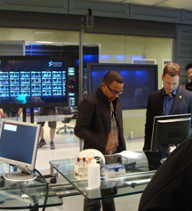


Problem definition
Necessity to lower compound identification time in the field.
Forensic Research Institute at FIU had a way to accomplish the quick identification of compounds but no effective way to share it.

Slide 3
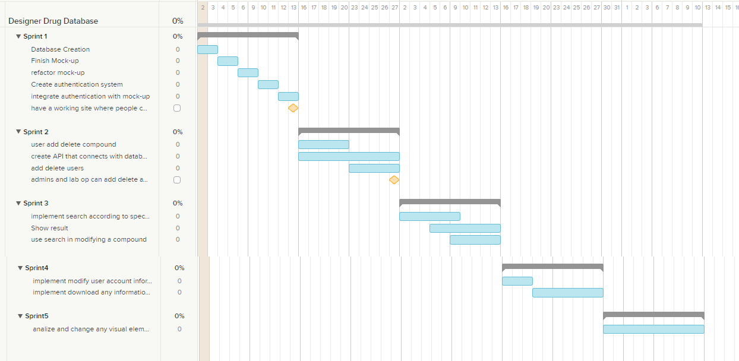
Project Managment

Slide 4

Requirements
The International Forensic Institute needed a tool to:
Share information with the world of Academia and the Professionals Community.
Manage shared information.
Control the access to the management of this information

Slide 5
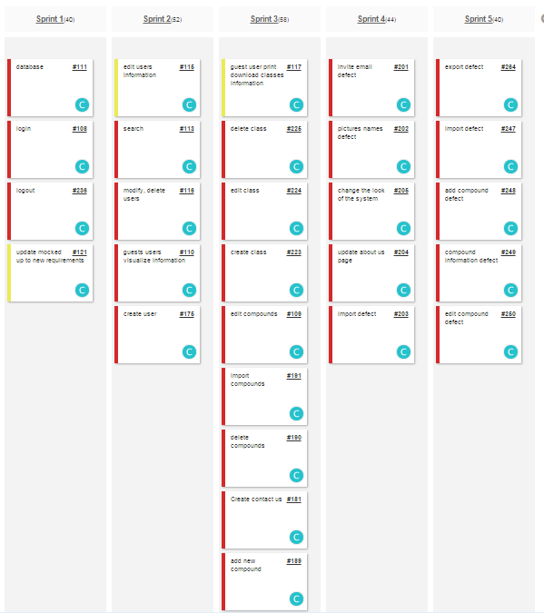
User Stories Implemented

Slide 6
Use Cases Implemented
Admins and lab operator must be able to login with their credentials
Admins and lab Operator must be able to add new compounds
Admins and lab Operator must be able to edit compounds
Admins and lab Operator must be able to delete compounds
Admins must be able to import compounds
Admins and Lab Operators must be able to modify their name.
Admins and Lab Operators must be able to modify their password.
Admins must be able to create new users in the system
Admins must be able to delete users of the system
Admins must be able to modify user roles of the system
Admins and Lab Operators must be able to see summary of the system in a dashboard.
Admins and Lab Operators must be able to read contact emails.
Admins and Lab Operators must be able to delete contact emails.
Admins and Lab Operators must be able to reply contact emails.
Any user of the system must be able to search and visualize the information of a compound.

Slide 7
Add Compound Use Case
Name: add new Compound
Participating actor: either an admin or a labOP
Entry condition: User is logged in the system User is in compound page.
Exit condition: Compound data is added in the system
Event flow: User click on the add compound button System shows add compound form page User selects the picture of the compound, fill the fields: name, formula, other name, mass, fragments, retention time, precursor, CAS. User add the corresponding transitions and click submit all button. System confirm that compound has been saved

Slide 8
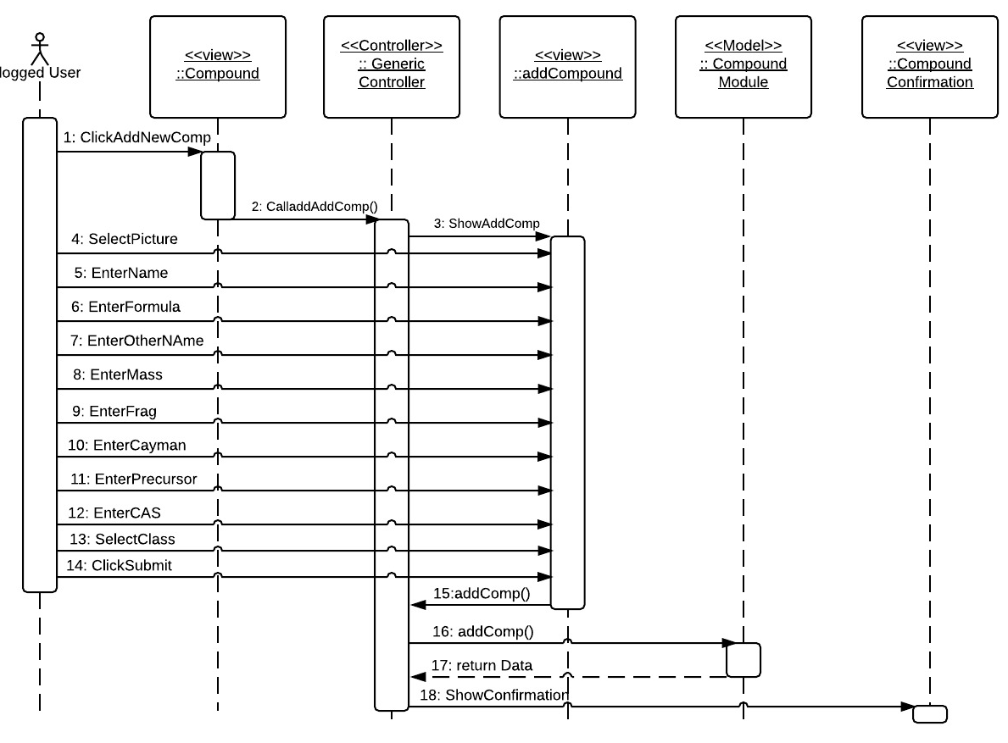
Add Compounds Sequence Diagram

Slide 9
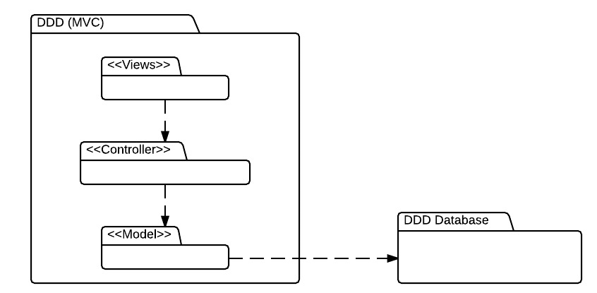
System Decomposition

Slide 10
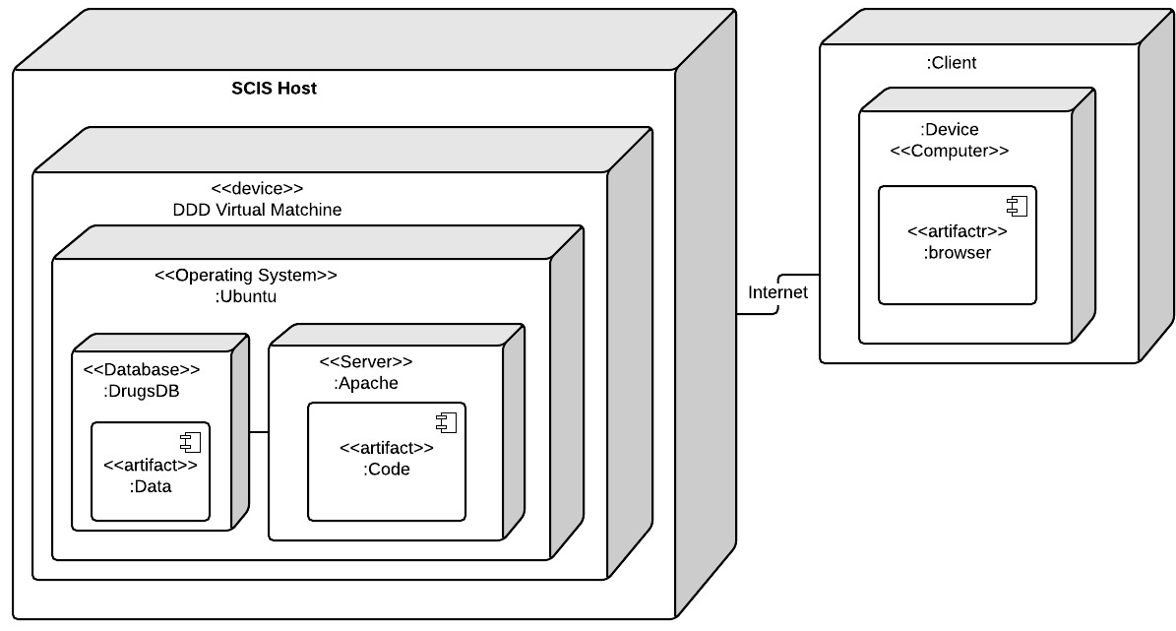
System Deployment

Slide 11
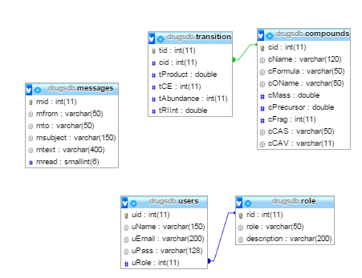
Persistent Data Design

Slide 12
Security Privacy
Encryption of data is only used for password and the type of encryption in use will be MD5.
Moreover, PDO with prepare statements have been use to prevent SQL Injections.

Slide 13
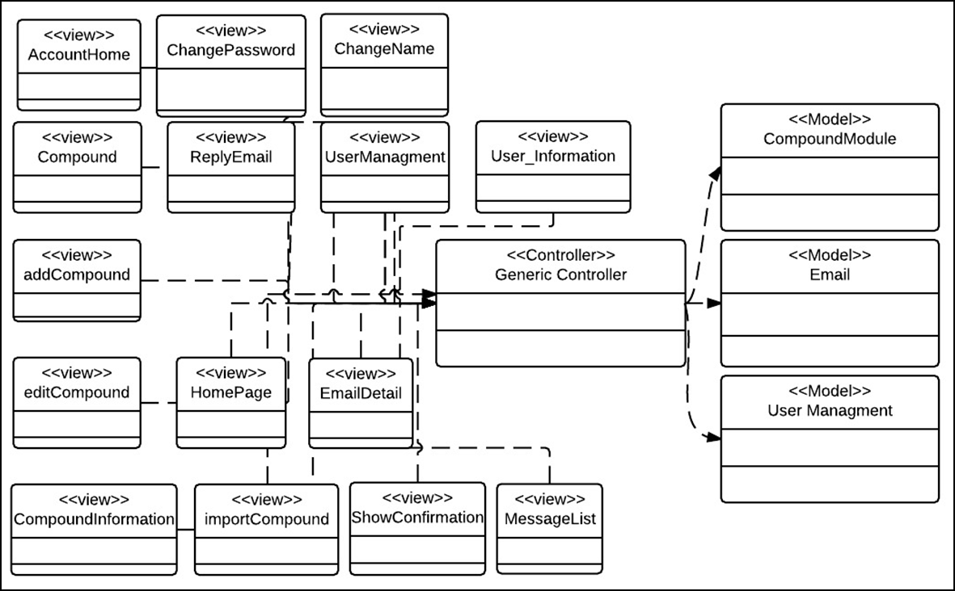
Minimal Class Diagram

Slide 14
State Machine

Slide 15
Main Algorithm

Slide 16
Test Suites
Name: add_new_Compound_SUNNY
Participating actor: either an admin or a labOP
Entry condition: User is logged in the system User is in compound page.
Exit condition: Compound data is added in the system and pop up is shown
Event flow: User click on the add compound button System shows add compound form page User selects the picture of the compound, enters “Test ” in name field, enters “Test” in formula field, enters “Test” in other name field, enters “5” in mass field, enters “5” in fragments field, enters “Test” in Cayman Number, enters “5” in precursor field, enters “6” in CAS field, select “Test51” as compound class and click submit all button. System confirm that compound has been saved with a pop up

Slide 17
Test Suite
Name: add_new_Compound_Rainy
Participating actor: either an admin or a labOP
Entry condition: User is logged in the system User is in compound page. Compound ‘Test’ already exist
Exit condition: Compound data is added in the system and pop up is shown
Event flow: User click on the add compound button System shows add compound form page User selects the picture of the compound, enters “Test ” in name field, enters “Test” in formula field, enters “Test” in other name field, enters “5” in mass field, enters “5” in fragments field, enters “Test” in Cayman Number, enters “5” in precursor field, enters “6” in CAS field, select “Test51” as compound class and click submit all button. System shows a pop up saying that compound already exist and cannot be added

Slide 18
DEMO

